Slide 1
Introduction to Optical Design Yuzuru Takashima, Ph.D.
Associate Professor College of Optical Sciences University of Arizona 1630 E. University Blvd. Tucson, AZ 85721 ytakashima@optics.arizona.edu www.optics.arizona.edu

Slide 2
Introduction to Optical Design Lecture #1
Yuzuru Takashima
College of Optical Sciences
ytakashima@optics.arizona.edu

Slide 3
Design Procedure
How to design lens system?
Exercise 1: Use catalog lens in CodeV
Review of 1st order optics
Why 1st order ? How 1st order optics are related to 3rd order aberrations?
Ray-trace

Slide 4
Design Procedure
1. Statement of problem to be solved:
Objective
Marketing and Technical statement
2. Alternative designs:
Several options for solving the stated problem/objective
1) Statement of problem to be solved:
Objective
Technical statement (PRD: Product Requirement Document)
Marketing statement (MRD: Marketing Requirement Document), which translates into a technical statement
2) Alternative designs:
Several options for solving the stated problem/objective
3) First order designs: geometrical design of optics
4) Evaluate against objectives
5) Select the most promising solution(s) (1st order. solution)
6) Carry out ray tracing design of most promising first order design
7) Evaluate design against objectives; optimize against “cost” factor
8) Go through loop 6, 7, 6, 7 until satisfactory results emerge, or 3, 4, 5, 6, 7
9) Carry out tolerance analysis, manufacturing and cost analysis, repeat 3-8 if necessary
10) Write report
3. First order designs:
4. Evaluate
against objectives
No
Yes
5. Select most promising solution(s)
(1st order solution)
6. Carry out 3rd order analysis
(3rd order solution)
7. Evaluate
against objectives
No
Yes
8. Carry out ray tracing design of most promising 1st order design
9. Carry out tolerance analysis, manufacturing and cost analysis
10. Evaluate
against objectives

Slide 5
Waterfall v.s. Agile Process
Waterfall process
Mainly used for a hardware design.
It is very important to follow the process!
A self-reviewing process
Logical development
Easy to recover errors

Slide 6
Agile Process
Agile Process
For software development, it is generally difficult to define PRD completely.
Look & Feel
User experience.
Specification
MRD
PRD
Testing

Slide 7
Example: 1) Statement of problem to be solved
Marketing statement:
I want to focus (and scan) a laser beam on a sample inside a vacuum chamber. Size of the chamber is 80mm in diameter.
Technical statement:
Focal length of 40mm is required, i.e. from requirements for scanning speed.
Wavelength:
Spot size:
f’=40mm.
Working distance (=fb) > 45mm.
Less number of elements is desirable for alignment.
Anything else?
Chamber
Laser
45mm
Optical
System
Sample
Scanning
mirror
80mm

Slide 8
2) Alternative designs 3) First order designs: geometrical design of optics
f’=-40
f’=+40
Start!
F’_{sys}
F’_{sys}
f’=40
Ray matrix
Graphical ray tracing
40
40
Single thin lens
f’=40mm
Two thin element system
f’_{sys}=40, fb = 80
Thick lens
(01LDX313,f=40mm)
Thick lens
01LDK117
f=-40mm
Thick lens
01LDX313
f=40mm
fb=39
n
F’_{sys}
F’_{sys}
F’_{sys}
H H’
H H’
H
H’
f’=40
40 n
80
40
79
Single thick lens
Single thick lens
Two thick lenses

Slide 9
4) Evaluate against objectives 5) Select most promising solution (1st order. solution)
fb=39
n
F’_{sys}
F’_{sys}
F’_{sys}
H H’
H H’
H
H’
f’=40
40 n
80
40
79
1) Single thick lens
2) Single thick lens
3) Two thick lenses
 | 1) Single thick lens | 2) Single thick lens | 3) Two thick lenses
1. λ=532nm | 532 | 532 | 532
2. f’sys =40mm | 40 | 40 | 40
3. fb>45mm | 39 (< 45) | 80 | 79
4. # of elements | 1 | 1 | 2
5. Spot size<10μm | 2.44λ(F/#)=4.15μm, (F/#)=3.2 | Need further evaluation by ray tracing (Step 6 and thereafter.) Note: too thick! (~60mm) | 2.44λ(F/#)=8.3μm, (F/#)=6.4 Need further evaluation by ray tracing (Step 6 and thereafter.)

Slide 10
Law of geometrical optics
1) Rays propagate along straight line in a homogeneous and isotropic medium.
2) Light is refracted from the boundary between two media having different propagation speeds, or indices of refraction (n=C_{o}/C, C_{o}: speed of light in vacuum). The incoming ray, the refracted ray, and the surface normal lie in a plane.
Snell’s Law (Law of refraction)
3) Upon reflection, the incoming, reflected ray and the surface normal lie in a plane.
Law of reflection

Slide 11
Law of geometrical optics
Besides the three law of geometrical optics, there are extremely important principles, which can be derived from the law of geometrical optics and vise versa
Huygens’ Principle (1690)
Fermat’s Principle (1650)
Eikonal Equation (1911)

Slide 12
Huygens’ Principle (1690)
Each element of a wavefront may be regarded as the center of a secondary disturbance which gives rise to spherical wavelets. The position of the wavefront at any later time is the envelope of all such wavelets. (Assume wavelets propagates in the direction of ray)

Slide 13
Fermat’s Principle (1650)
A light ray always forms a trajectory that makes the optical path length (OPL) a stationary value: in general a minimum, sometimes a maximum.

Slide 14
Eikonal Equation (1911)
The square of the gradient of the Ekonal* is equal to the index of refraction squared.

Slide 15
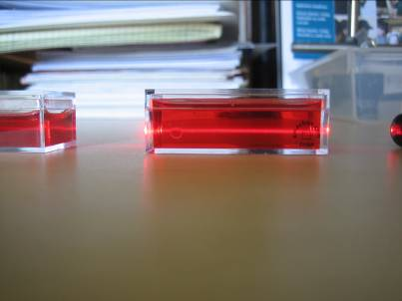
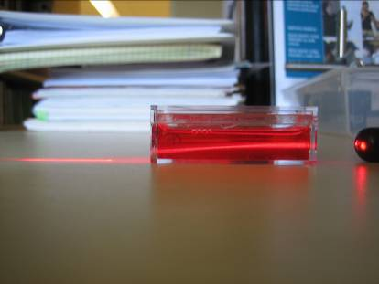
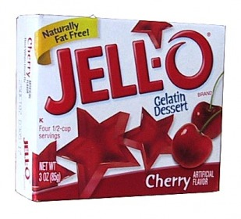
Jell-O Gradient Index Lens

Slide 16
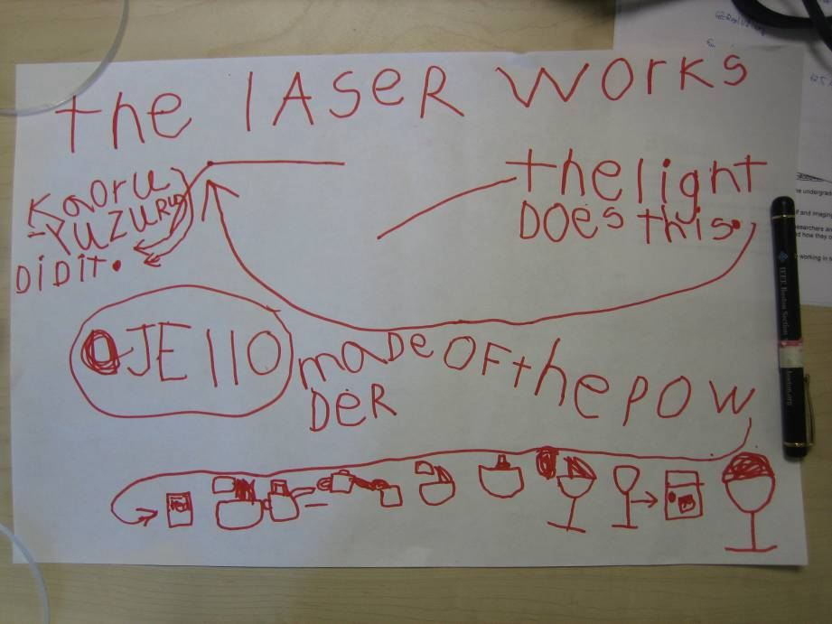
Fabrication Recipe

Slide 17
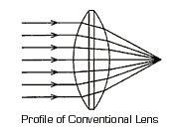
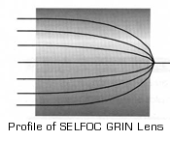
GRIN lens
n ~ 1.5
Light wave
Light wave
n: Index of refraction ~ 1.5
Velocity in glass = c/n

Slide 18

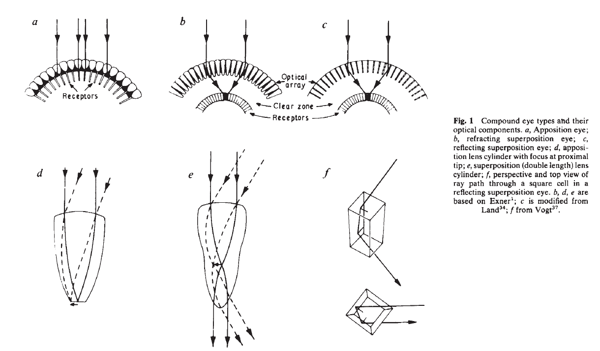
Two types of compound eyes
http://www.nature.com/nature/journal/v287/n5784/pdf/287681a0.pdf
Apposition Eyes
2) Superposition Eyes
(nocturnal insects, crustaceans)

Slide 19
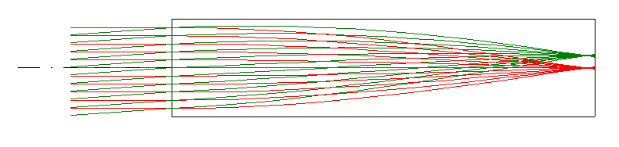
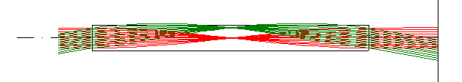
Modeling of Compound Eyes Apposition and Superposition Eyes
Apposition Eyes
GrinSingleFocus.seq
2) Superposition Eyes
GrinUnitTele.seq

Slide 20
Review: 1st order optics

